Slide 1
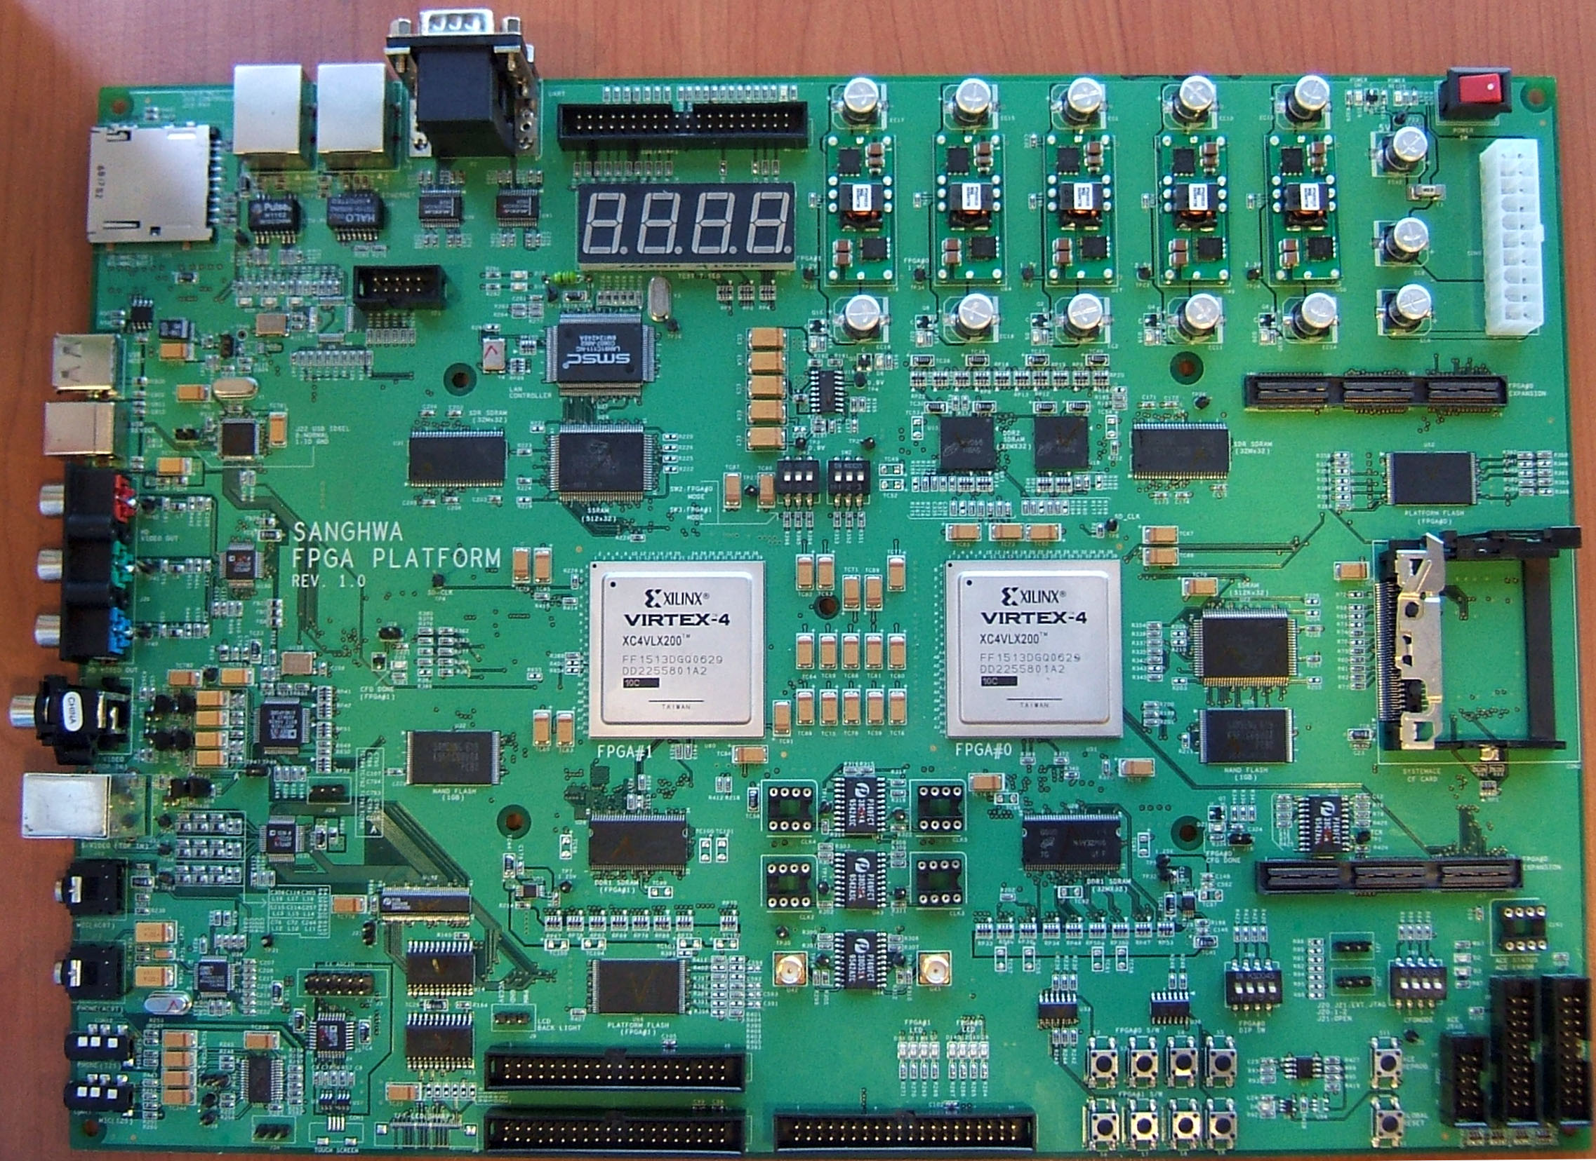
FPGA Board
PCI Expansion Board
PCI Adaptor Board
ROM Emulator Socket
FPGA
MICTOR Adaptor Board
RF Board

Slide 2
PCI Expansion Board
PCI Expansion Board
PCI Adaptor Board
Vertex4
LX60 – FF668
Grade 낮 은것.
모든 가용 Pin을 Connector에 연결
그리고 일부를 ROM Emulator
Socket에 공유
공유된 Pin은 0Ohm 저항으로 Isolation
ROM Emulator Socket
FPGA
연결 Connector는 최대한 짧은 거리를 유지

Slide 3
PCI Expansion Board
Power Socket
HDD Type
Regulator
Circuit
OSC Socket
FPGA
Signal from/to
PCI Adaptor Board
Signal from/to PCI Socket
7 Seg * 4

